Slide 1
Overview Of Language Processors
Presented by: Foram Thakor

Slide 2
Overview
Language Processors
Language processing systems
Language processing activities
Fundamentals of language processing
Toy compiler
Search data structure
Allocation data structure

Slide 3
Language Processors
A Language Processor is a software which bridges a specification or execution gap.
Program to input to a LP is referred as a Source Program and output as Target Program.
A language translator bridges an execution gap to the machine language of a computer system.
Language processors are essential tools that translate human-readable code into machine-executable instructions.
Language processors are tools that convert human-readable code into a form that computers can execute.

Slide 4
Language Processing Systems
Any computer system is made of hardware and software, The hardware understands a language, which humans cannot understand.
So we write programs in high-level language, which is easier for us to understand and remember.
These programs are then fed into a series of tools and OS components to get the desired code that can be used by the machine.
This is known as Language Processing System.
The high-level language is converted into binary language in various phases.

Slide 5
Language Processing Systems
A compiler is a program that converts high-level language to assembly language.
Similarly, an assembler is a program that converts the assembly language to machine-level language.
A linker tool is used to link all the parts of the program together for execution (executable machine code).
A loader loads all of them into memory and then the program is executed.

Slide 6
Language Processing Systems
Different kinds of Language Processors are as follows:
Preprocessor
A preprocessor, generally considered as a part of compiler, is a tool that produces input for compilers.
Processes source code before it is compiled.
Tasks:
Macro Expansion: Replaces macros with their definitions.
File Inclusion: Incorporates content of other files.
Conditional Compilation: Compiles code based on certain conditions.
Use: Simplifies coding by allowing code reuse and conditional compilation.
Example Languages: C, C++ (using directives like #include, #define).

Slide 7
Language Processing Systems
2. Compiler
A compiler reads the whole source code at once, creates tokens, checks semantics, generates intermediate code, executes the whole program and may involve many passes.
Translate high-level programming languages (e.g., C, C++, Java) into machine code.
Tasks: Lexical Analysis, Syntax Analysis, Semantic Analysis, Optimization, Code Generation.

Slide 8
Language Processing Systems
3. Interpreter
An interpreter, like a compiler, translates high-level language into low-level machine language.
An interpreter reads a statement from the input, converts it to an intermediate code, executes it, then takes the next statement in sequence.
If an error occurs, an interpreter stops execution and reports it. whereas a compiler reads the whole program even if it encounters several errors.
Executes high-level code line-by-line without converting it into machine code beforehand.

Slide 9
Language Processing Systems
3. Assembler
An assembler translates assembly language programs into machine code.
The output of an assembler is called an object file, which contains a combination of machine instructions as well as the data required to place these instructions in memory.
Used in system programming for tasks requiring hardware control.

Slide 10
Language Processing Systems
4. Linker
Linker is a computer program that links and merges various object files together in order to make an executable file.
All these files might have been compiled by separate assemblers.
The major task of a linker is to search and locate referenced module/routines in a program and to determine the memory location where these codes will be loaded, making the program instruction to have absolute references.

Slide 11
Language Processing Systems
5. Loader
Loader is a part of operating system and is responsible for loading executable files into memory and execute them.
It calculates the size of a program (instructions and data) and creates memory space for it. It initializes various registers to initiate execution.
6. Cross-compiler
A compiler that runs on platform (A) and is capable of generating executable code for platform (B) is called a cross-compiler.
Source-to-source Compiler A compiler that takes the source code of one programming language and translates it into the source code of another programming language is called a source-to-source compiler.

Slide 12
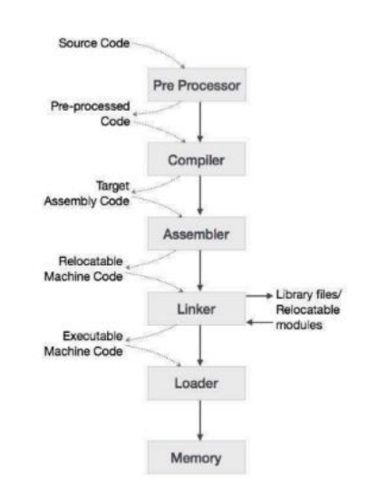
Language Processing Systems

Slide 13
Language Processing Activities
Language processing activities arises due to the differences between the manner in which the software designer describes the ideas and the manner in which the ideas are implemented.
The designer expresses the idea related to the application domain of the software.
To implement these ideas, the description of the ideas has to be interpreted as related to the execution domain of the computer system.
We use the term “Semantics” to represent the “rules of the domain”.
The term “Semantic Gap” represents the difference between the semantics of two domain.

Slide 14
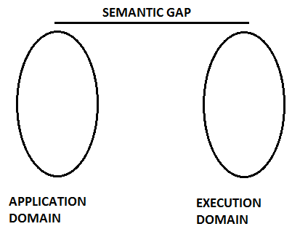
Language Processing Activities
The semantic gap has many consequences, some of the important ones being:
Large Development Cycles (time)
Large Development Efforts
Poor quality softwares
These issues can be tackled by using Software Engineering steps:
Specification, Design and coding steps
PL implementation

Slide 15
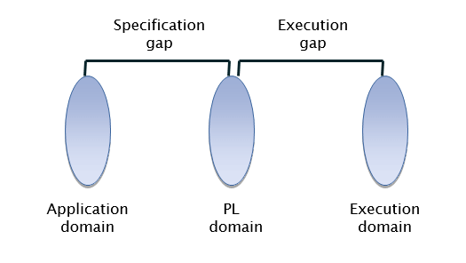
Language processors after the introduction of PL domain:

Slide 16
Language Processing Activities
There are mainly two types of language processing activity which bridges the semantic gap between source language and target language:
Program generation activities
Program execution activity.
A program generation activity aims at automatic generation of a program.
The source language is a specification language of an application domain and the target language is typically a procedure oriented PL.
A program execution activity organizes the execution of a program written in a PL on a computer system.
Its source language could be a procedure oriented language or a problem oriented language.

Slide 17
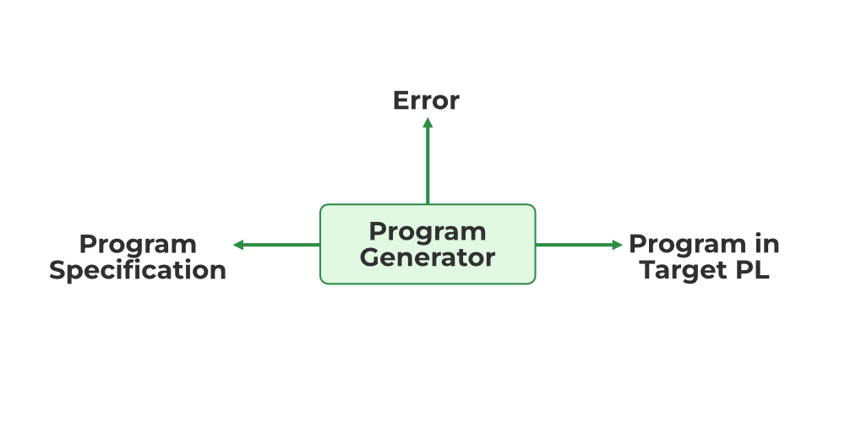
Program Generation Activities
This activity generates a program from its specification program. Program generation activity bridges the specification gap.
A program generator is a software system program that accepts the specifications of the program to be generated and generates the program in the target program in a target programming language.
The program generator introduces a new domain between the application and the programming language domain called the program generator domain.

Slide 18
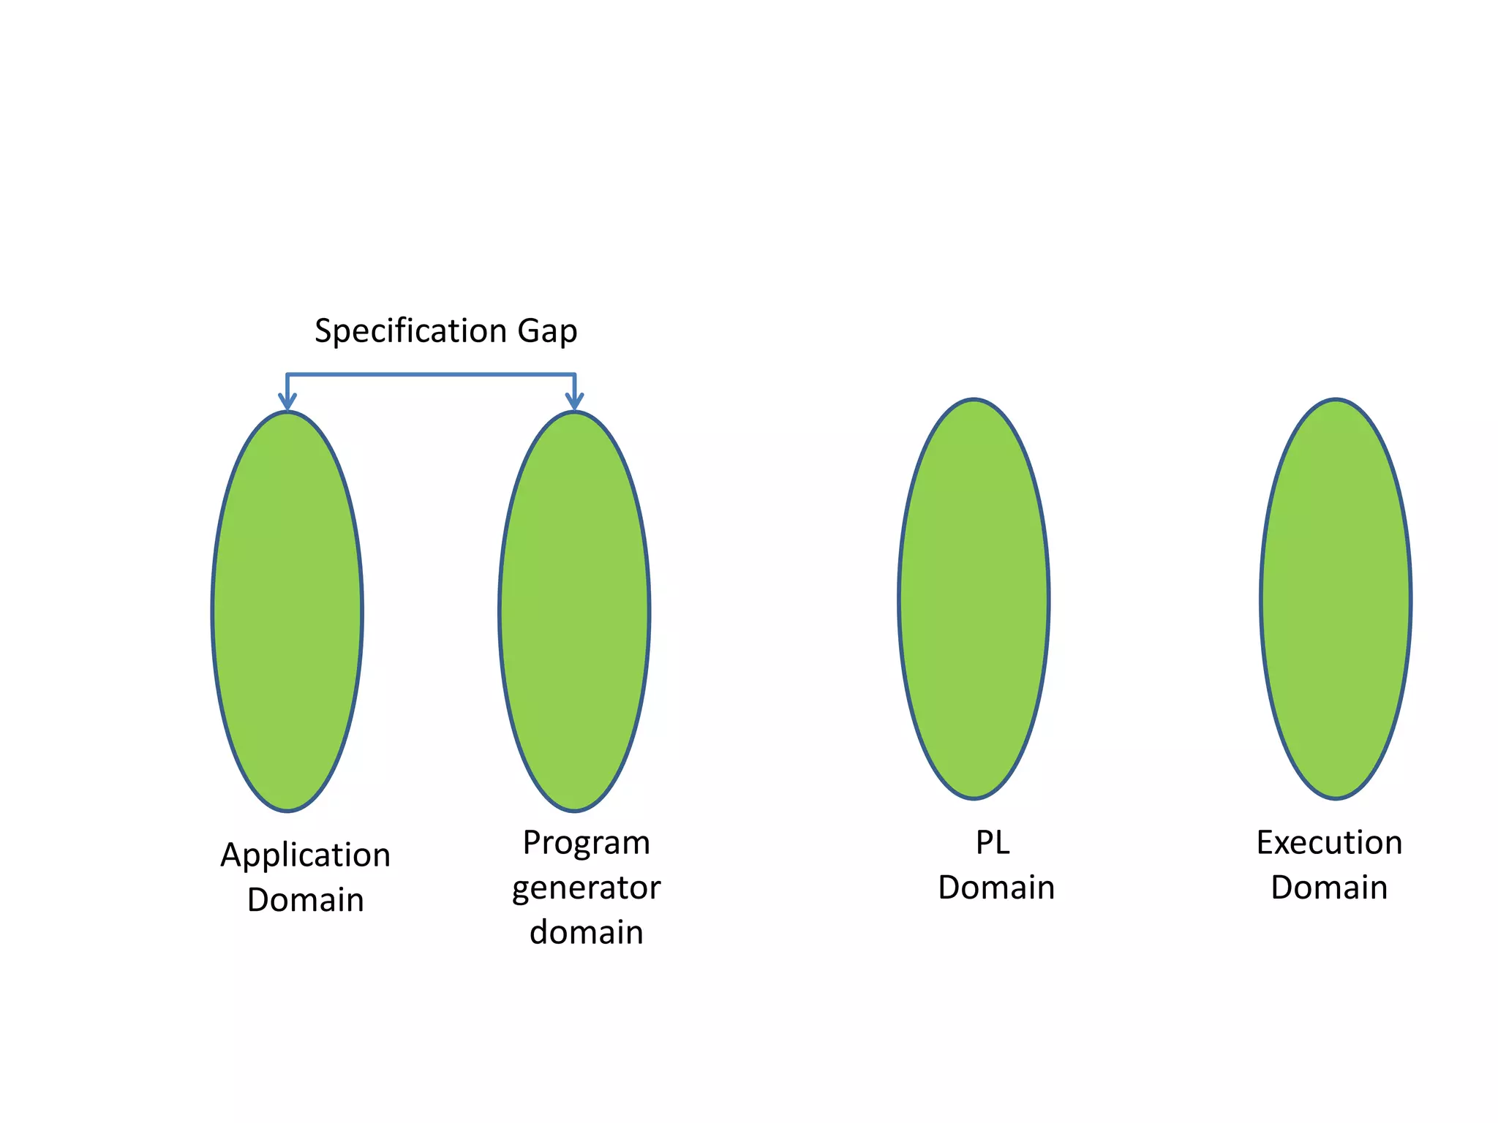

Slide 19
Program Execution Activities
This activity aims at bridging the execution gap by organizing the execution of a program written in a programming language on a computer system.
A program may be executed through Translation and Interpretation.
Working:
This activity involves the actual execution of the program generated by the program generator. The program execution activity bridges the implementation gap.
The program execution activity involves loading the program into the memory of the computer system, interpreting the program instructions, and executing them on the computer system.

Slide 20
Program Execution Activities (Contd.)
During program execution, the computer system reads the program instructions from memory and executes them one by one, performing the necessary computations and producing the desired results.
The program execution activity involves various components of the computer system, including the processor, memory, input/output devices, and other system resources required to execute the program.
In summary, the program generation activity generates a program from its specification, while the program execution activity involves the actual execution of the program on the computer system.

Slide 21
Program Execution Activities (Contd.)
Program Translation:
The program translation model bridges the execution gap by translating a program written in a programming language called the source program into an equivalent program in the machine language called the target program.
A program must be translated before it can be executed.
A translated program may save in a file. So that, we can execute saved files or programs repeatedly.

Slide 22
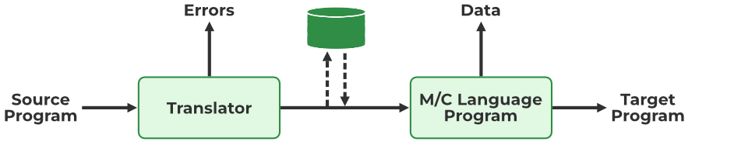
Program Translation

Slide 23
Program Execution Activities (Contd.)
2. Program Interpretation
The interpreter reads the source program and stores it in its memory. Throughout interpretation takes a statement, finds its meaning, and performs actions that implement this. This includes computational and input-output actions.
The CPU uses a program counter (PC) to note the address of the next instruction to be executed.
This Instruction is subjected to the instruction execution cycle consisting of the following steps:
Fetch the instruction.
Decode the instruction to determine the operation to be performed, and also its operands.
Execute the Instruction

Slide 24
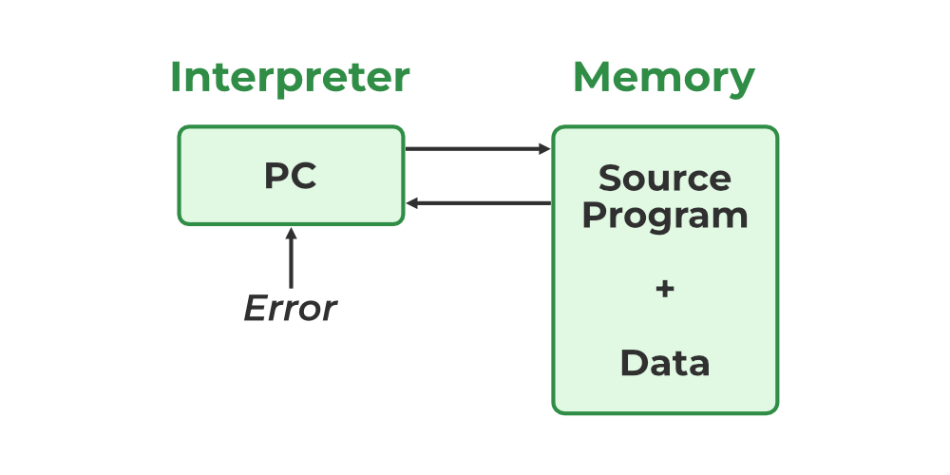
Program Interpretation

Slide 25
Fundamentals of Language Processing
Phases | Passes
Phases refer to the logical stages in the process of translating source code to executable code. Break down the compilation process into manageable and modular tasks. Each phase focuses on a specific aspect of compilation, such as syntax or semantics. Modular approach makes debugging and maintenance easier. | Passes refer to the number of times the compiler scans the entire source code or intermediate representation. Allow for thorough analysis and optimization of the code. Each pass may involve multiple phases or focus on specific optimization tasks. Multi-pass compilers are generally more efficient in terms of the final code quality.

Slide 26
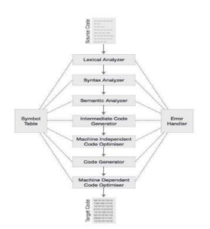

Slide 27
Fundamentals of Language Processing (Contd.)
Language Processor = Analysis of SP + Synthesis of TP
Analysis Phase:
Known as the front-end of the compiler, the analysis phase of the compiler reads the source program, divides it into core parts and then checks for lexical, grammar and syntax errors.
The analysis phase generates an intermediate representation of the source program and symbol table, which should be fed to the Synthesis phase as input.
It is responsible for understanding the structure and meaning of the source code.

Slide 28
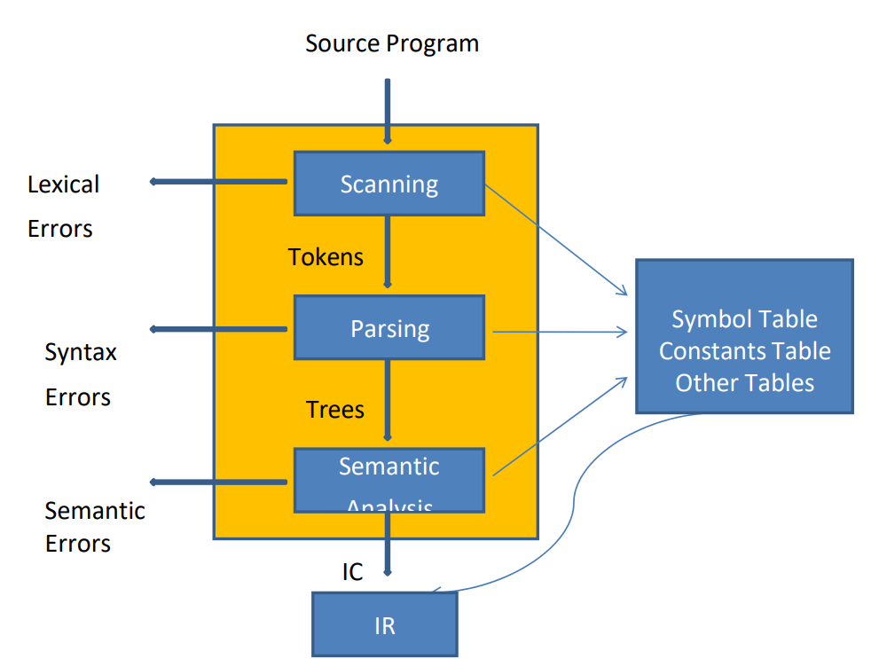

Slide 29
Analysis Phase
This phase can be further divided into several sub-phases:
Lexical Analysis:
Purpose: Convert the sequence of characters in the source code into tokens.
Activities: Scanning and tokenizing the source code.
Output: Tokens (basic syntactic units like keywords, identifiers, literals, operators).
Example: Converting int a = 5; into tokens [int, a, =, 5, ;].
Lexical analyzer represents these lexemes in the form of tokens as: Lexical analysis builds a descriptor, called a token.
<token-name, attribute-value>
We represent token as entry “Code #no” where “Code” can be Id or Op for identifier or operator respectively and “no” indicates the entry for the identifier or operator in symbol or operator table.

Slide 30
Example of Lexical Analysis
Consider following code:
i: integer;
a, b: real;
a= b + i;
The statement a= b+i is represented as a string of token
a = b + i
Id#1 Op#1 Id#2 Op#2 Id#3

Slide 31
Analysis Phase(Contd.)
2. Syntax Analysis (Parsing):
Purpose: Determine the grammatical structure of the source code.
Activities: Constructing a parse tree from the tokens.
Output: Parse tree or abstract syntax tree (AST).
Example: Verifying that int a = 5; follows the rules of the language's grammar.
Syntax analysis processes the string of token to determine its grammatical structure builds an intermediate code that represents the structure.
The tree structure is used to represent the intermediate code.

Slide 32
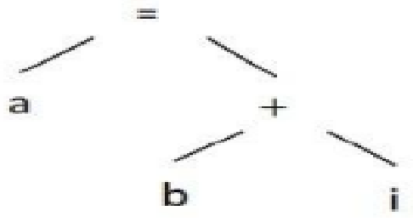
Example of Syntax Analysis
Consider the statement a = b + i can be represented in tree form as:

Slide 33
Analysis Phase(Contd.)
3. Semantic Analysis:
Purpose: Ensure the code makes logical sense.
Activities: Type checking, scope resolution, and verifying that operations are semantically valid.
Output: Annotated syntax tree.
Example: Checking that variables are declared before use and that operations are performed on compatible types.
While processing a declaration statement, it adds information concerning the type, length and dimensionality of a symbol to the symbol table.
While processing an imperative statement, it determines the sequence of actions that would have to be performed for implementing the meaning of the statement and represents them in the intermediate code.

Slide 34
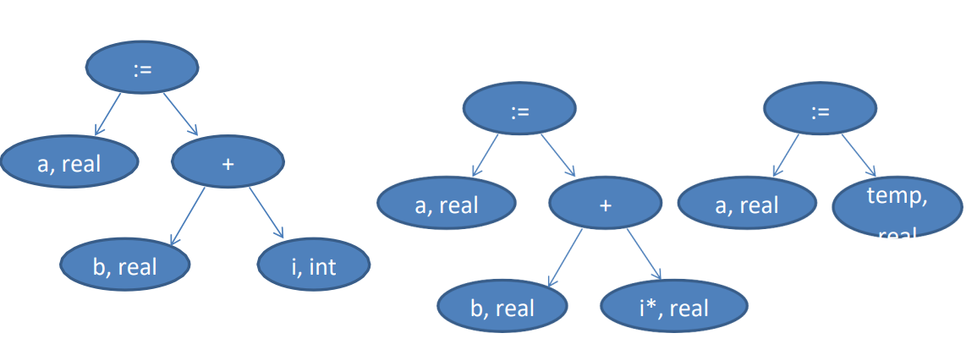
Example of Semantic Analysis
Considering the tree structure for the statement a = b + i
If node is operand, then type of operand is added in the description field of operand. While evaluating the expression the type of b is real and i is int so type of i is converted to real i*.

Slide 35
Analysis Phase(Contd.)
4. Intermediate Code(IC) Generation:
Purpose: Convert the high-level source code into an intermediate representation (IR).
Activities: Generating a platform-independent intermediate code.
Output: Intermediate code.
Example: Transforming int a = 5; into an intermediate form like three-address code.
IR contains intermediate code and table.

Slide 36
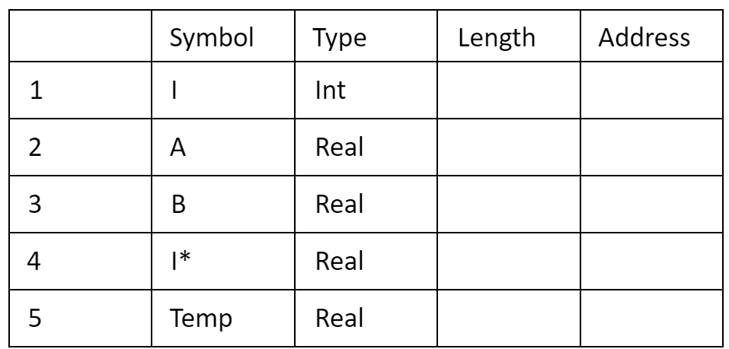
Example of Intermediate Code Generation:
Symbol table:
Intermediate code:
Convert(id1#1) to real, giving (id#4)
Add(id#4) to (id#3), giving (id#5)
Store (id#5) in (id#2)

Slide 37
What is the need of Intermediate Code?
A source code can directly be translated into its target machine code, then why at all we need to translate the source code into an intermediate code which is then translated to its target code? Let us see the reasons why we need an intermediate code.
If a compiler translates the source language to its target machine language without having the option for generating intermediate code, then for each new machine, a full native compiler is required.
Intermediate code eliminates the need of a new full compiler for every unique machine by keeping the analysis portion same for all the compilers.
The second part of compiler, synthesis, is changed according to the target machine.
It becomes easier to apply the source code modifications to improve code performance by applying code optimization techniques on the intermediate code.

Slide 38
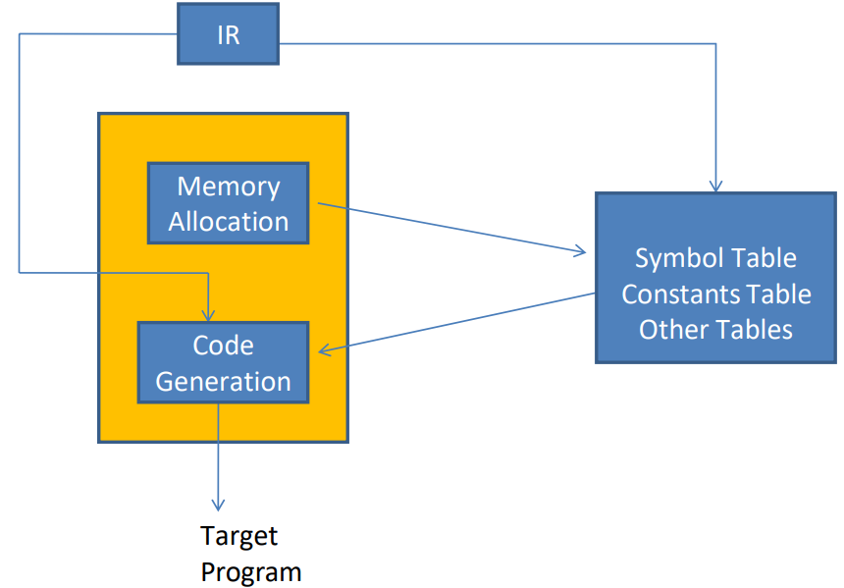
Synthesis Phase
The synthesis phase, also known as the back-end of a compiler, is responsible for translating the intermediate representation of a program into machine code that can be executed by the target processor.

Slide 39
Synthesis Phase (Contd.)
The key tasks it performs are as follows:
Code Optimization
Improve the intermediate code to enhance performance and reduce resource usage.
Activities: Removing redundant code, optimizing loops, and enhancing resource utilization.
Output: Optimized intermediate code.
Example: Eliminating dead code and simplifying expressions to reduce the number of instructions.

Slide 40
Synthesis Phase(Contd.)
2. Code Generation
Purpose: Translate the optimized intermediate code into machine code.
Activities:
Instruction Selection: Mapping intermediate instructions to the target machine instructions.
Register Allocation: Assigning variables and temporary values to machine registers.
Instruction Scheduling: Reordering instructions to minimize pipeline stalls and improve execution speed.
Output: Machine code instructions.
Example: Converting an intermediate representation of an addition operation to the appropriate ADD machine instruction.

Slide 41
Synthesis Phase(Contd.)
3. Creation of Data Structures
Purpose: Set up runtime structures required during program execution.
Activities:
Symbol Table Management: Storing information about variables, functions, scopes, and types.
Activation Records: Managing function calls and local variables using stack frames.
Control Flow Graphs (CFG): Representing the flow of control within the program.
Output: Symbol tables, activation records, and CFGs.
Example: Creating an activation record for a function call to manage local variables and return address.

Slide 42
Intermediate Representation (IR)
IR serve as a bridge between the source code and the target machine code, providing an abstraction that enables various optimizations and transformations.
Intermediate codes can be represented in a variety of ways and they have their own benefits.
High Level IR
High-level intermediate code representation is very close to the source language itself. They can be easily generated from the source code and we can easily apply code modifications to enhance performance. But for target machine optimization, it is less preferred.
Low Level IR
This one is close to the target machine, which makes it suitable for register and memory allocation, instruction set selection, etc. It is good for machine-independent optimization.

Slide 43
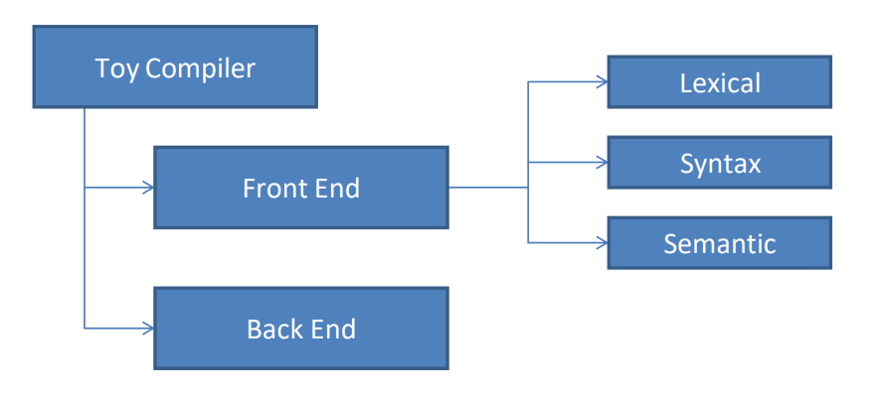
Toy Compiler

Slide 44
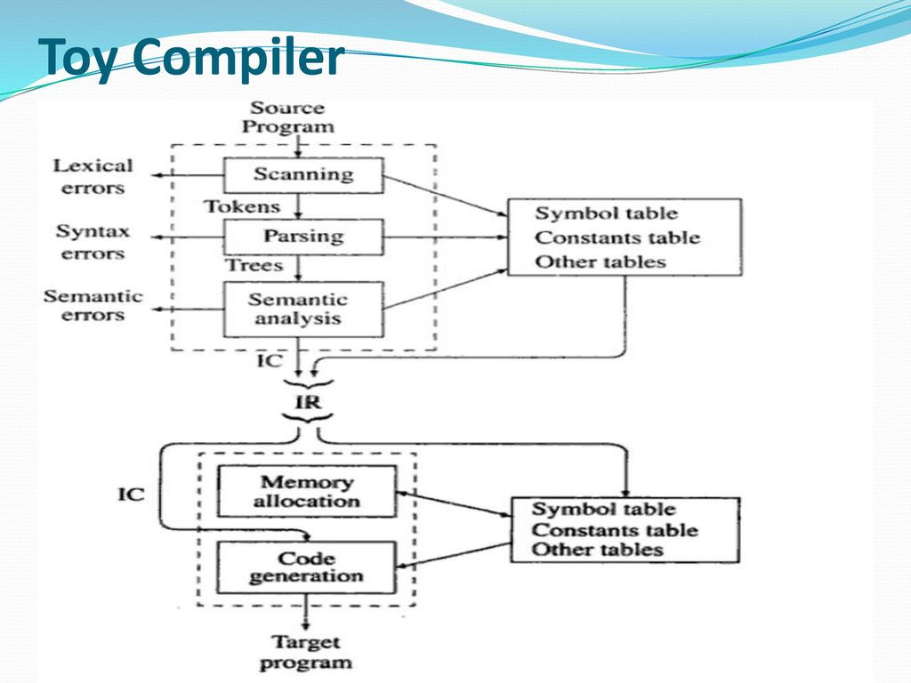

Slide 45
Toy Compiler (Contd.) – Frontend
It includes 3 analysis:
Lexical analysis
Syntax analysis
Semantic analysis
Functions of Front End:
Determine validity of source statement from view point of analysis.
Determine ‘content’ of source statement.
Construct a suitable representation of source statement for the use of subsequent analysis function or synthesis phase of a language processor.
Result is stored in the following forms:
Table of Information
IC: Description of source statement
Output of Front End:
IR : Intermediate Representation.
It has two things with it. 1. Table of Information. 2. Intermediate Code (IC)

Slide 46
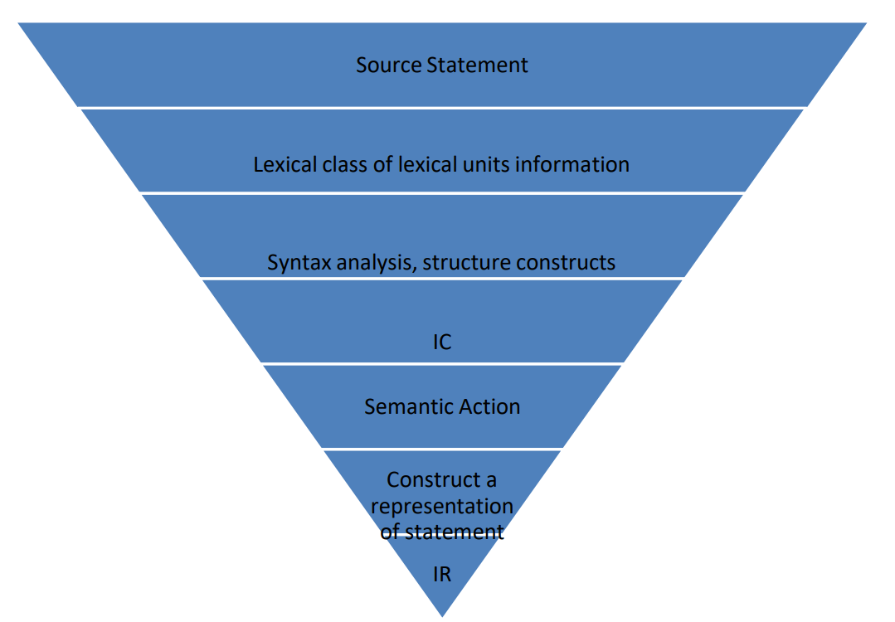
Toy Compiler (Contd.) – Frontend

Slide 47
Toy Compiler (Contd.) – Backend
The main tasks it performs:
Memory Allocation
A memory allocation requirement of an identifier is computed from its Size, Length, Type, Dimension – And then memory is allocated to it.
The address of memory area is then entered in symbol table.
Code Generation
Uses knowledge of target architecture.
Knowledge of instruction
Addressing mode in target computer.
Important issues affecting code generation:
Determine the place where the intermediate results should be kept. i.e in memory or register?
Determine which instruction should be used for type conversion operation.
Determine which addressing mode should be used for accessing variable.

Slide 48
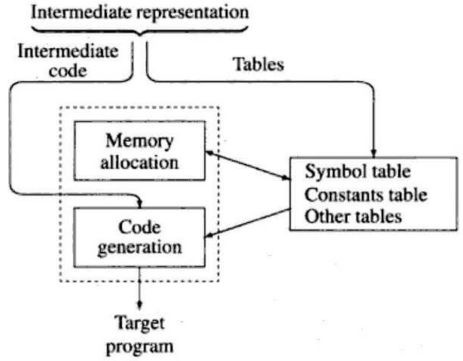
Toy Compiler (Contd.) – Backend

Slide 49
Symbol Table
Symbol table is an important data structure created and maintained by compilers in order to store information about the occurrence of various entities such as variable names, function names, objects, classes, interfaces, etc.
Symbol table is used by both the analysis and the synthesis parts of a compiler.
A language processor uses the symbol table to maintain the information about attributes of symbols used in a source program.

Slide 50
Symbol Table (Contd.)
It performs the following four kinds of operations on the symbol table:
Add a symbol and its attributes: Make a new entry in the symbol table.
Locate a symbol’s entry: Find a symbol’s entry in the symbol table.
Delete a symbol’s entry: Remove the symbol’s information from the table.
Access a symbol’s entry: Access the entry and set, modify or copy its attribute information.
The symbol table consists of a set of entries organized in memory.

Slide 51
Symbol Table (Contd.)
A symbol table may serve the following purposes depending upon the language in hand:
To store the names of all entities in a structured form at one place.
To verify if a variable has been declared.
To implement type checking, by verifying assignments and expressions in the source code are semantically correct.
To determine the scope of a name (scope resolution).
A symbol table is simply a table which can be either linear or a hash table. It maintains an entry for each name in the following format:
<symbol name, type, attribute>

Slide 52
Symbol Table (Contd.)
For example,
if a symbol table has to store information about the following variable declaration: static int interest;
then it should store the entry such as:
<interest, int, static>
The attribute clause contains the entries related to the name.

Slide 53
Implementation
If a compiler is to handle a small amount of data, then the symbol table can be implemented as an unordered list, which is easy to code, but it is only suitable for small tables only.
A symbol table can be implemented in one of the following ways:
Linear (sorted or unsorted) list
Binary Search Tree
Hash table
Among all, symbol tables are mostly implemented as hash tables, where the source code symbol itself is treated as a key for the hash function and the return value is the information about the symbol.

Slide 54
Operations – insert()
A symbol table, either linear or hash, should provide the following operations.
insert()
This operation is more frequently used by analysis phase, i.e., the first half of the compiler where tokens are identified and names are stored in the table.
This operation is used to add information in the symbol table about unique names occurring in the source code.
The format or structure in which the names are stored depends upon the compiler in hand.
An attribute for a symbol in the source code is the information associated with that symbol.

Slide 55
Operations – insert() (Contd.)
This information contains the value, state, scope, and type about the symbol. The insert() function takes the symbol and its attributes as arguments and stores the information in the symbol table.
For example:
int a;
should be processed by the compiler as:
insert(a, int);

Slide 56
Operations – lookup()
lookup() operation is used to search a name in the symbol table to determine:
if the symbol exists in the table.
if it is declared before it is being used.
if the name is used in the scope.
if the symbol is initialized.
if the symbol declared multiple times.
The format of lookup() function varies according to the programming language.
The basic format should match the following: lookup(symbol)
This method returns 0 (zero) if the symbol does not exist in the symbol table.
If the symbol exists in the symbol table, it returns its attributes stored in the table.

Slide 57
Data Structures for Language Processing
Two kinds of data structures can be used for organizing its entries:
Linear data structure: Entries in the symbol table occupy adjoining areas of memory. This property is used to facilitate search.
Non-linear data structure: Entries in the symbol table do not occupy contiguous areas of memory. The entries are searched and accessed using pointers.

Slide 58
Symbol Table Entry Formats
Each entry in the symbol table is comprised of fields that accommodate the attributes of one symbol. The symbol field of fields stores the symbol to which entry pertains.
The symbol field is key field which forms the basis for a search in the table.
The following entry formats can be used for accommodating the attributes:
Fixed length entries: Each entry in the symbol table has fields for all attributes specified in the programming language.
Variable-length entries: The entry occupied by a symbol has fields only for the attributes specified for symbols of its class.
Hybrid entries: A hybrid entry has fixed-length part and a variable-length part.

Slide 59
Search Data Structures
Search data structures (Search structure) is used to create and organize various tables of information and mainly used during the analysis of the program.
The important features of search data structures include the following:
An entry in search data structure is essentially a set of fields referred to as a record.
Every entry in search structure contains two parts: fixed and variable. The value in fixed part determines the information to be stored in the variable part of the entry.

Slide 60
Operations On Search Data structures
Insert Operation:
To add the entry of a newly found symbol during language processing.
Search Operation:
To enable and support search and locate activity for the entry of symbol
Delete Operation:
To delete the entry of a symbol especially when identified by processor as redundant declarations.

Slide 61
Sequential Search Organization – Linear Search
In sequential search organization, during the search for a symbol, probability of all active entries being accessed in the table is same.
For an unsuccessful search, the symbol can be entered using an ‘add’ operation into table.
It operates by checking each element in a list or array one by one from the beginning to the end until the target element is found or the entire list has been searched.
If found: If the current element matches the target, return the index of the element.
If not found: If the current element does not match the target, move to the next element.

Slide 62
Linear Link List
Linear list organization is the simplest and easiest way to implement the symbol tables.
It can be constructed using single array or equivalently several arrays that store names and their associated information.
During insertion of a new name, we must scan the list to ensure whether it is a new entry or not.
If an entry is found during the scan, it may update the associated information but no new entries are made.
The advantage of using list is that it takes minimum possible space. On the other hand, it may suffer for performance for larger values of 'n' and 'm’, where ‘n’ is names and ‘m’ is the information associated with the name.

Slide 63
Self Organizing List
Searching in symbol table takes most of the time during symbol table management process.
The pointer field called 'LINK' is added to each record, and the search is controlled by the order indicated by the ‘LINK’.
A pointer called 'FIRST' can be used to designate the position of the first record on the linked list, and each 'LINK' field indicates the next record on the list.
Self-organizing list is advantageous over simple list implementation in the sense that frequently referenced name variables will likely to be at the top of the list.
If the access is random, the self-organizing list will cost time and space.

Slide 64
Binary Search Organization
Binary search is a highly efficient algorithm for finding an element in a sorted list or array.
It operates by repeatedly dividing the search interval in half, making it significantly faster than linear search for large datasets.
Find Middle:
Calculate the middle index (mid) of the current search interval.
Compare:
Compare the target element with the element at the middle index.
If the target is equal to the middle element, the search is complete.
If the target is less than the middle element, adjust the high pointer to mid - 1 and repeat.
If the target is greater than the middle element, adjust the low pointer to mid + 1 and repeat.

Slide 65
Search Trees
Symbol tables can also be organized as binary tree organization with two pointer fields, namely, 'LEFT' and 'RIGHT' in each record that points to the left and right sub trees respectively.
The left subtree of the record contains only records with names less than the current records name.
The right subtree of the node will contain only records with name variables greater than the current name.
The advantage of using search tree organization is that it proves efficient in searching operations, which are the most performed operations over the symbol tables.
A binary search tree gives performance compared to list organization at some difficulty in implementation.

Slide 66
Hash Table Organization
A hash table, also known as a hash map is a data structure that has the ability to map keys to the values using a hash function.
It is based on a concept called hashing, which involves using a hash function to convert keys into indices in an array, where the corresponding values are stored
Hash Function:
A function that takes an input (or 'key') and returns an index in the hash table array.
Indexing:
The key is passed through the hash function, and the resulting index determines where the value associated with the key will be stored in the array.
Collision Handling:
When two keys hash to the same index, a collision occurs. Various strategies are used to handle collisions.

Slide 67
Allocation Data Structures
Allocation strategy is an important factor in efficient utilization of memory for objects, defining their scope and lives using either static, stack, or heap allocations.
Heap
A heap is a specialized tree-based data structure that satisfies the heap property.
Heaps are typically used to implement priority queues and for efficient sorting (heapsort).
This means that the tree is completely filled on all levels except possibly the lowest, which is filled from left to right.
Heaps are a kind of non-linear data structure that permits allocation and deallocation of list of entities in any (random) order as needed.

Slide 68
Allocation Data Structure (Contd.)
Heap Operations:
Insert: Add a new element to the heap and restore the heap property.
Extract (Max or Min): Remove and return the root element and restore the heap property.
Peek (Max or Min): Return the root element without removing it.
2. Stack
Stack is a linear data structure that satisfies last-in first-out (LIFO) policy for its allocation and deallocation.
This makes only last element of the stack accessible at any time.
Implementing stack data structure requires use of Stack Base (SB) that points to first entry of stack, and a Top of Stack (TOS) pointer to point to last entry allocated to stack.

Slide 69
Allocation Data Structure (Contd.)
Stack Operations
Push: Add an element to the top of the stack.
Pop: Remove and return the top element of the stack.
Peek (Top): Return the top element without removing it.
IsEmpty: Check if the stack is empty.

Slide 70


